Slide 1
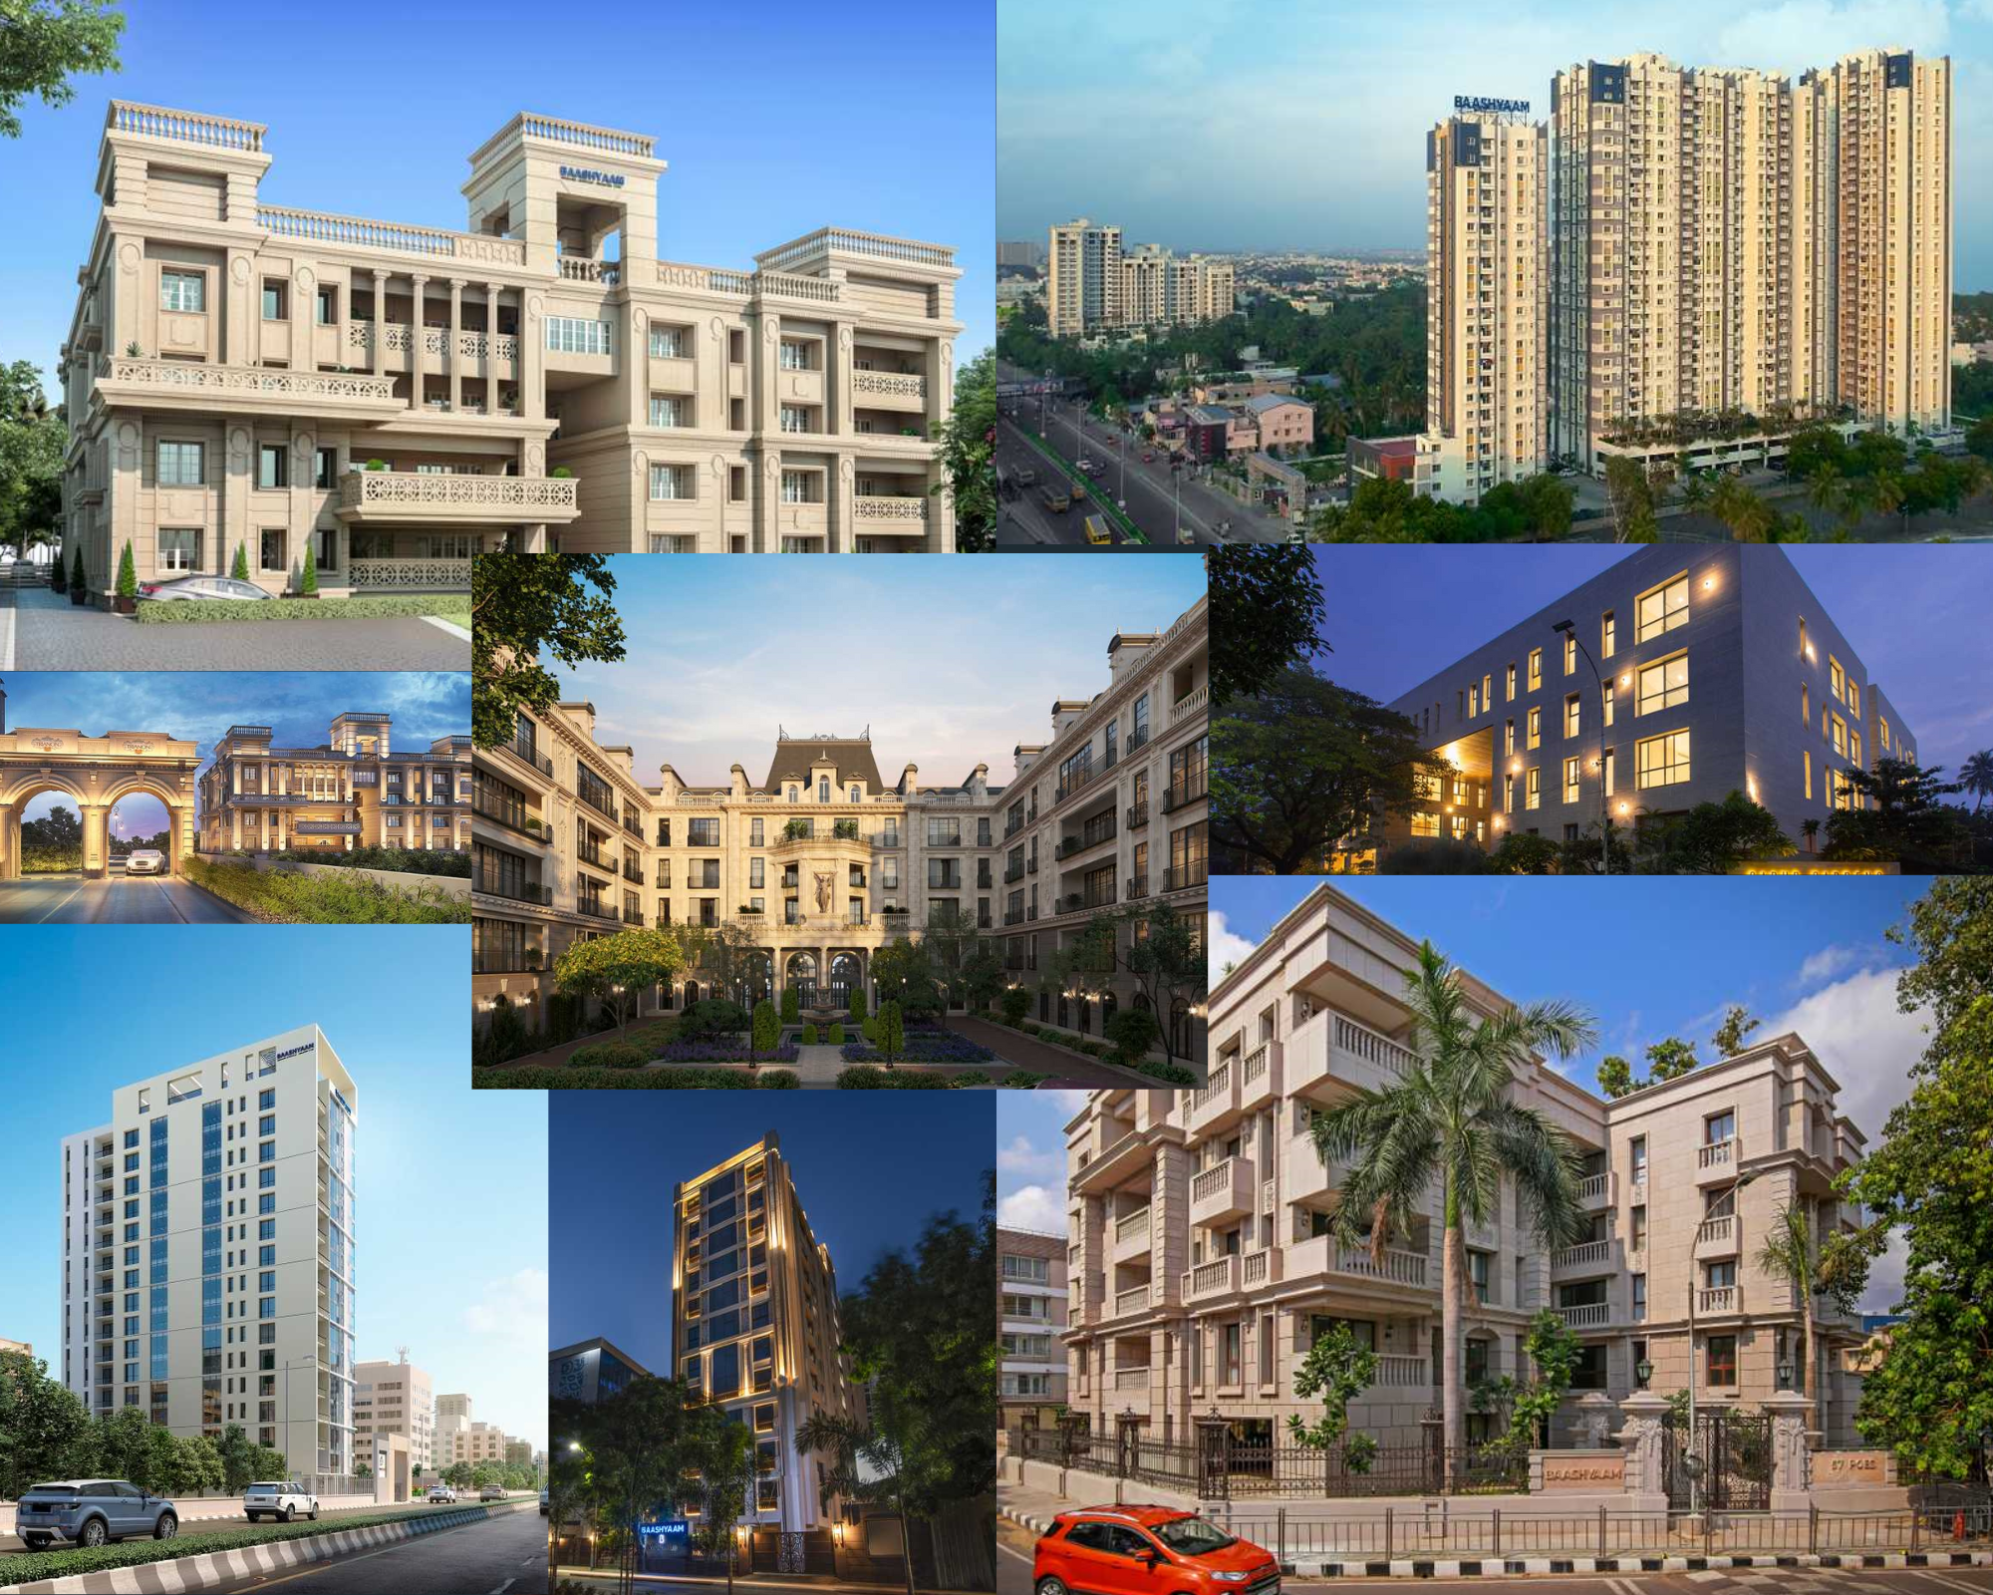


Baashyaam Project Management Services One click solution for all home maintenance

Slide 2
Table of Content
01
Overview
02
Role Hierarchy
03
Functionalities
04
Sample Use Cases
05
Technology Stack and Architecture

Slide 3


Overview
An efficient solution designed to meet all your home maintenance needs with a click!
Plumbing,
Civil,
Electrical,
House Keeping,
Security
Other Services etc..
Our system enables the oversight of creation and management of service requests for residents residing in pre-configured properties.
This innovative solution offers residents the convenience of effortlessly discovering and scheduling services according to their preferred availability.
Residents receive real-time updates on service progress and can communicate effortlessly with service providers.

Slide 4
Role Hierarchy
Super Administrator
Administrator 1
Technician 1
Technician 2
Administrator 2
Administrator “N*”
Technician “N*”
Technician 1
Technician 2
Technician “N*”
Technician 1
Technician “N*”
Technician 2
Owner
Residents – Apartment 1
Residents – Apartment 2
Residents – Apartment “N*”
# N* - Infinite
# Multiple Super Administrators can be added based on the region/ Demographics
# An admin can manage 1 or more properties

Slide 5
Functionalities
Super Administrator
Who ? | Manage Overall Properties and assign / manage Admins
Functionalities | Manage apartment lists, areas, and service configurations Create Administrator profiles and assign apartments to them Create Technician profiles with services, experience, location, contact, verification details, bank details, time availability, preferred apartment lists Manage Technician profiles Validate Technician profiles View service requests based on area, apartment, or Administrator Manage escalations for missed or delayed services
Administrator
Who ? | Manage all Technicians and service requests assigned to them
Functionalities | Login to the system Create Technician profiles with services, experience, location, contact, verification details, bank details, time availability, preferred apartment lists Manage Technician profiles Approve resident profiles for their assigned areas or apartments View service request dashboards for their areas or apartments Create service request for residents in their assigned areas or apartments Assign service requests to Technicians Manage the lifecycle of service requests View service request history Generate service request reports Generate Technicians performance reports

Slide 6
Functionalities
User
Who ? | Residents
Functionalities | Login to the system Sign up with apartment details from a dropdown list (Administrator approval is required) Choose the desired service and create a service request with preferred primary and secondary times, specific instructions, etc. View or update service requests Make payments for services Provide feedback Update their profile information Reach out to support for any queries.
Technician
Who ? | Electricians, Plumbers, Carpenters, AC mechanic, Security, Landscaping, etc.
Functionalities | Login to the system Access an order dashboard with options to acknowledge and execute the service requests Manage their contact details

Slide 7

Sample Use case
Service Request Creation for Electrical Work
Status: FIXED
Registered Resident
Technician
Administrator
Create SR for Electrical Maintenance work at their preferred Slot
Service Request (SR) Flow
Validate the SR and Assign it to right electrician
Assign it to Electrician
Accept the SR
Confirmation Notification
SR Status Update & Notification
Completing the SR
SR Status Update & Notification
Payment Gateway Integration – Credit Card, Debit Card, UPI, Net Banking & E-Wallet
SR Status Update & Notification
3rd Party Integration
Payment Completion (Online or Cash)
*** Notification Mechanism - E-mail, SMS & Mobile App Notifications (based on scenarios)
Payment Completion Status to Administrator
Close the SR
Feedback about the Service (Optional)

Slide 8
Sample Use case
Service Request Creation for Electrical Work
Status: FURTHER ACTION
Registered Resident
Technician
Administrator
Create SR for Electrical Maintenance work at their preferred Slot
Service Request (SR) Flow
Validate the SR and Assign it to right electrician
Assign it to Electrician
Accept the SR
Confirmation Notification
SR Status Update & Notification
Further Action Required
SR Status Update & Notification
SR Status Update & Notification
Creates Quote
Acknowledge Quote and Child SR created
*** Notification Mechanism - E-mail, SMS & Mobile App Notifications (based on scenarios)
SR Status Update & Notification
Validate the SR and Assign it to right electrician
Child SR will follow the SR Lifecycle

Slide 9










Technology Stack
Front end: Angular
API: Golang
Android: Kotlin
IOS: Swift
Database: MySQL, Mongo DB and Cassandra for archiving
Security: SSL and JWT based authentication.
Integration: Payment (Razor Pay , Google Pay), SMS (Text2Local) & E-Mail (GoDaddy)
Hosting Cloud: AWS or Azure
Architecture: Microservices

Slide 10
Architecture
Channels
Android
iOS
Web channels
Whatsapp
Alexa
IVR
3rd Party Tools
Rest API Calls
SMS
Main
API
Layer
Routers
E-Mail
Rest API Calls
Controllers
Middleware
RAZOR pay
Util
Log files
Services
Whatsapp
Not in the current scope
Mongo DB
Cassandra

Slide 11

Thank you !!!

Slide 12

Solution Benefits
BAASHYAAM
RESIDENTS
Automation helps ensure that service requests are processed quickly and accurately and also eliminate errors.
Benefits
Increased accuracy
Convenience
Real-time updates & Service History
Payment integration
Seamless communication
Improved resident service
Cost savings
Increased efficiency
Convenience of finding and booking home maintenance services from their smartphones. With just a few clicks, residents can schedule maintenance services at their preference, view service history, and communicate with service providers
Streamlines the process of managing home maintenance services, reducing the amount of time and effort. This result is in increased efficiency and productivity
Real Time status tracking along with Notifications on the progress. View past services, invoices, and payment history.
Zero Revenue leakage, Less Manual Intervention in co-ordination with Technicians which will significantly bring down administrative costs
Pay for the services directly through the app, while service providers can receive payment through the app's payment gateway. This eliminates the need for cash transactions and ensures that payments are secure.
Provides residents with real-time updates on the status of their service requests, allowing them to stay informed throughout the entire process. This helps to improve resident satisfaction, as well as build a positive reputation for the service provider.
Seamless communication between residents and service providers. Easily communicate with service providers through in-app messaging or phone calls. This ensures that any issues are resolved quickly and efficiently

